Slide 1
Motivating Employees
Chapter
16

Slide 2
L E A R N I N G O U T L I N E
Follow this Learning Outline as you read and study this chapter.
What Is Motivation?
  Define motivation.
  Explain motivation as a need-satisfying process.
Early Theories of Motivation
  Describe Maslow’s hierarchy of needs and how it can be used to motivate.
  Discuss how Theory X and Theory Y managers approach motivation.
  Describe Herzberg’s motivation-hygiene theory.
  Explain Herzberg’s views of satisfaction and dissatisfaction.

Slide 3
L E A R N I N G O U T L I N E (cont’d)
Follow this Learning Outline as you read and study this chapter.
Contemporary Theories of Motivation
  Describe the three needs McClelland proposed as being present in work settings.
  Explain how goal-setting and reinforcement theories explain employee motivation.
  Describe the job characteristics model as a way to design motivating jobs.
  Discuss the motivation implications of equity theory.
  Contrast distributive justice and procedural justice.
  Explain the three key linkages in expectancy theory and their role in motivation.

Slide 4
L E A R N I N G O U T L I N E (cont’d)
Follow this Learning Outline as you read and study this chapter.
Current Issues in Motivation
  Describe the cross-cultural challenges of motivation.
  Discuss the challenges managers face in motivating unique groups of workers.
  Describe open-book management, employee recognition, pay-for-performance, and stock option programs.

Slide 5
What Is Motivation?
Motivation
  Is the result of an interaction between the person and a situation; it is not a personal trait.
  Is the process by which a person’s efforts are energized, directed, and sustained towards attaining a goal.
    Energy: a measure of intensity or drive.
    Direction: toward organizational goals
    Persistence: exerting effort to achieve goals.
  Motivation works best when individual needs are compatible with organizational goals.

Slide 6
Early Theories of Motivation
Maslow’s Hierarchy of Needs
MacGregor’s Theories X and Y
Herzberg’s Two-Factor Theory

Slide 7
Early Theories of Motivation
Maslow’s Hierarchy of Needs Theory
  Needs were categorized as five levels of lower- to higher-order needs.
    Individuals must satisfy lower-order needs before they can satisfy higher order needs.
    Satisfied needs will no longer motivate.
    Motivating a person depends on knowing at what level that person is on the hierarchy.
  Hierarchy of needs
    Lower-order (external): physiological, safety
    Higher-order (internal): social, esteem, self-actualization

Slide 8
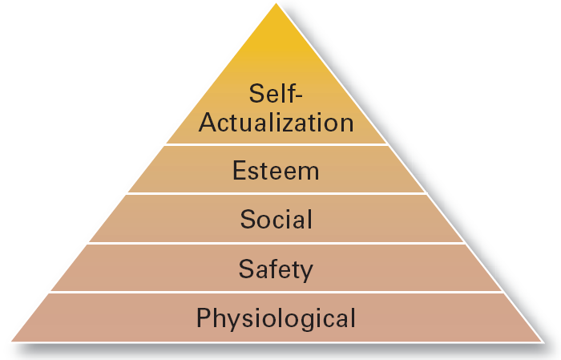
Exhibit 16–1 Maslow’s Hierarchy of Needs

Slide 9
Early Theories of Motivation (cont’d)
McGregor’s Theory X and Theory Y
  Theory X
    Assumes that workers have little ambition, dislike work, avoid responsibility, and require close supervision.
  Theory Y
    Assumes that workers can exercise self-direction, desire responsibility, and like to work.
  Assumption:
    Motivation is maximized by participative decision making, interesting jobs, and good group relations.

Slide 10
Early Theories of Motivation (cont’d)
Herzberg’s Motivation-Hygiene Theory
  Job satisfaction and job dissatisfaction are created by different factors.
    Hygiene factors: extrinsic (environmental) factors that create job dissatisfaction.
    Motivators: intrinsic (psychological) factors that create job satisfaction.
  Attempted to explain why job satisfaction does not result in increased performance.
    The opposite of satisfaction is not dissatisfaction, but rather no satisfaction.

Slide 11
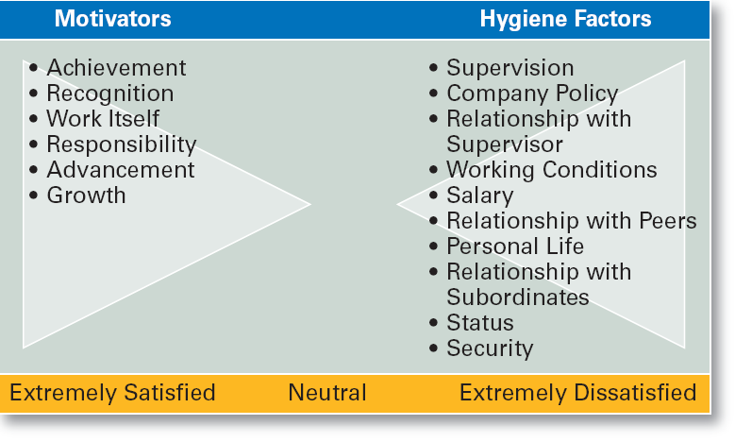
Exhibit 16–2 Herzberg’s Motivation-Hygiene Theory

Slide 12
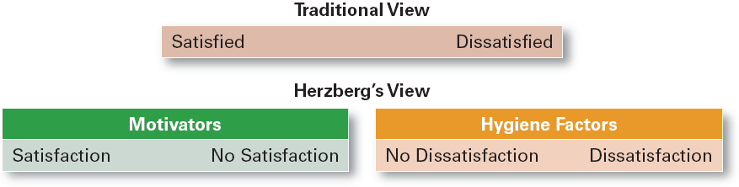
Exhibit 16–3 Contrasting Views of Satisfaction-Dissatisfaction

Slide 13
Contemporary Theories of Motivation
Three-Needs Theory
Goal-Setting Theory
Reinforcement Theory
Designing Motivating Jobs
Equity Theory
Expectancy Theory

Slide 14
Motivation and Needs
Three-Needs Theory (McClelland)
  There are three major acquired needs that are major motives in work.
    Need for achievement (nAch)
      The drive to excel and succeed
    Need for power (nPow)
      The need to influence the behavior of others
    Need of affiliation (nAff)
      The desire for interpersonal relationships

Slide 15
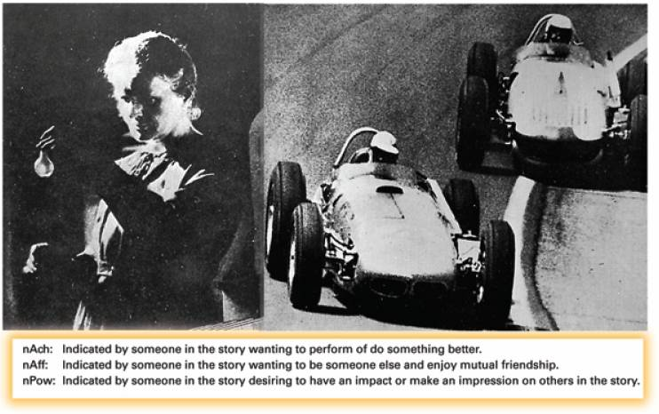
Exhibit 16–4 Examples of Pictures Used for Assessing Levels of nAch, nAff, and nPow

Slide 16
Motivation and Goals
Goal-Setting Theory
  Proposes that setting goals that are accepted, specific, and challenging yet achievable will result in higher performance than having no or easy goals.
  Is culture bound to the U.S. and Canada.
Benefits of Participation in Goal-Setting
  Increases the acceptance of goals.
  Fosters commitment to difficult, public goals.
  Provides for self-feedback (internal locus of control) that guides behavior and motivates performance (self-efficacy).

Slide 17
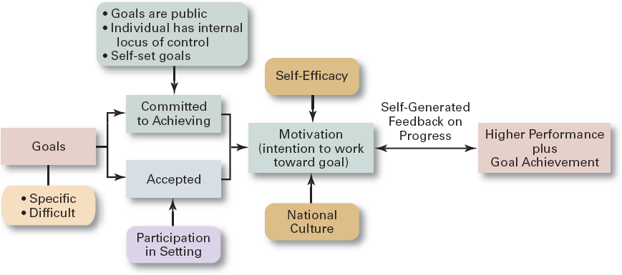
Exhibit 16–5 Goal-Setting Theory

Slide 18
Motivation and Behavior
Reinforcement Theory
  Assumes that a desired behavior is a function of its consequences, is externally caused, and if reinforced, is likely to be repeated.
    Positive reinforcement is preferred for its long-term effects on performance
    Ignoring undesired behavior is better than punishment which may create additional dysfunctional behaviors.

Slide 19
Designing Motivating Jobs
Job Design
  The way into which tasks can be combined to form complete jobs.
  Factors influencing job design:
    Changing organizational environment/structure
    The organization’s technology
    Employees’ skill, abilities, and preferences
  Job enlargement
    Increasing the job’s scope (number and frequency of tasks)
  Job enrichment
    Increasing responsibility and autonomy (depth) in a job.

Slide 20
Designing Motivating Jobs (cont’d)
Job Characteristics Model (JCM)
  A conceptual framework for designing motivating jobs that create meaningful work experiences that satisfy employees’ growth needs.
  Five primary job characteristics:
    Skill variety: how many skills and talents are needed?
    Task identity: does the job produce a complete work?
    Task significance: how important is the job?
    Autonomy: how much independence does the jobholder have?
    Feedback: do workers know how well they are doing?

Slide 21
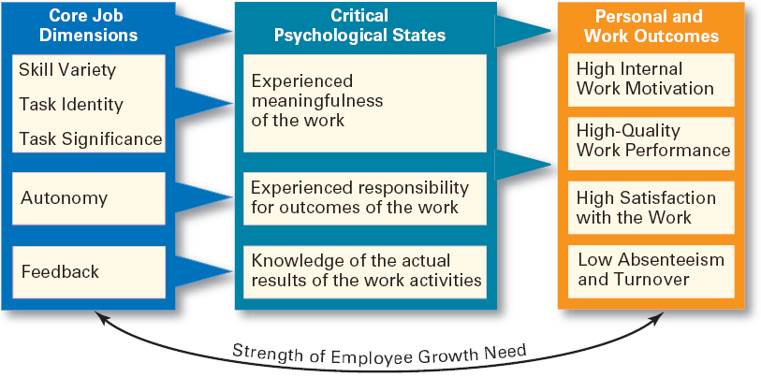
Exhibit 16–6 Job Characteristics Model
Source: J.R. Hackman and J.L. Suttle (eds.). Improving Life at Work (Glenview, IL: Scott, Foresman, 1977). With permission of the authors.

Slide 22
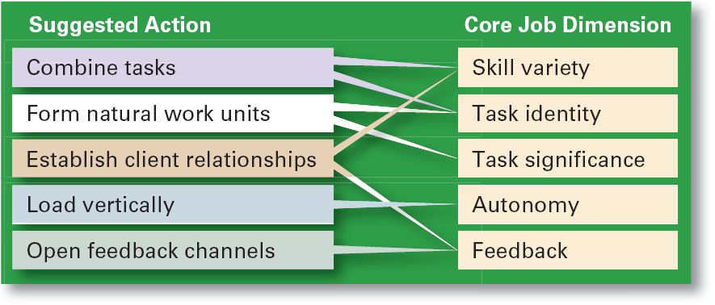
Exhibit 16–7 Guidelines for Job Redesign
Source: J.R. Hackman and J.L. Suttle (eds.). Improving Life at Work (Glenview, IL: Scott, Foresman, 1977). With permission of the authors.

Slide 23
Designing Motivating Jobs (cont’d)
Suggestions for Using the JCM
  Combine tasks (job enlargement) to create more meaningful work.
  Create natural work units to make employees’ work important and whole.
  Establish external and internal client relationships to provide feedback.
  Expand jobs vertically (job enrichment) by giving employees more autonomy.
  Open feedback channels to let employees know how well they are doing.

Slide 24
Motivation and Perception
Equity Theory
  Proposes that employees perceive what they get from a job situation (outcomes) in relation to what they put in (inputs) and then compare their inputs-outcomes ratio with the inputs-outcomes ratios of relevant others.
    If the ratios are perceived as equal then a state of equity (fairness) exists.
    If the ratios are perceived as unequal, inequity exists and the person feels under- or over-rewarded.
    When inequities occur, employees will attempt to do something to rebalance the ratios (seek justice).

Slide 25
Motivation and Perception (cont’d)
Equity Theory (cont’d)
  Employee responses to perceived inequities:
    Distort own or others’ ratios.
    Induce others to change their own inputs or outcomes.
    Change own inputs (increase or decrease efforts) or outcomes (seek greater rewards).
    Choose a different comparison (referent) other (person, systems, or self).
    Quit their job.
  Employees are concerned with both the absolute and relative nature of organizational rewards.

Slide 26
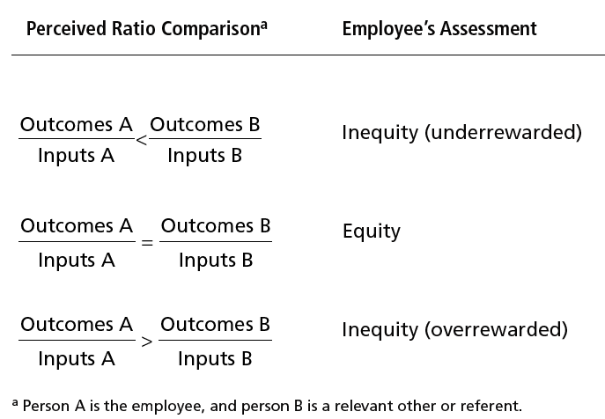
Exhibit 16–8 Equity Theory

Slide 27
Motivation and Perception (cont’d)
Equity Theory (cont’d)
  Distributive justice
    The perceived fairness of the amount and allocation of rewards among individuals (i.e., who received what).
      Influences an employee’s satisfaction.
  Procedural justice
    The perceived fairness of the process use to determine the distribution of rewards (i.e., how who received what).
      Affects an employee’s organizational commitment.

Slide 28
Motivation and Behavior
Expectancy Theory (Vroom)
  States that an individual tends to act in a certain way based on the expectation that the act will be followed by a given outcome and on the attractiveness of that outcome to the individual.
  Key to the theory is understanding and managing employee goals and the linkages among and between effort, performance and rewards.
    Effort: employee abilities and training/development
    Performance: valid appraisal systems
    Rewards (goals): understanding employee needs

Slide 29
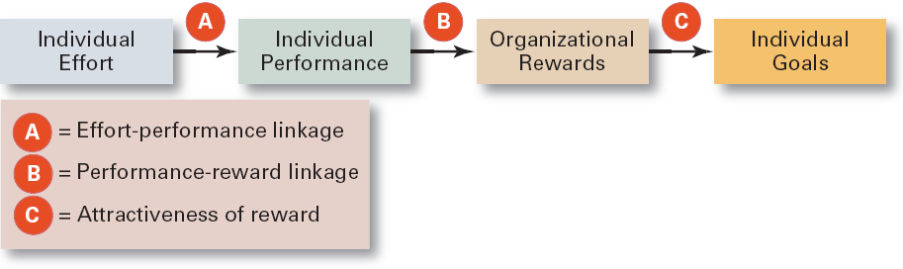
Exhibit 16–9 Simplified Expectancy Model

Slide 30
Motivation and Behavior (cont’d)
Expectancy Relationships
  Expectancy (effort-performance linkage)
    The perceived probability that an individual’s effort will result in a certain level of performance.
  Instrumentality
    The perception that a particular level of performance will result in the attaining a desired outcome (reward).
  Valence
    The attractiveness/importance of the performance reward (outcome) to the individual.

Slide 31
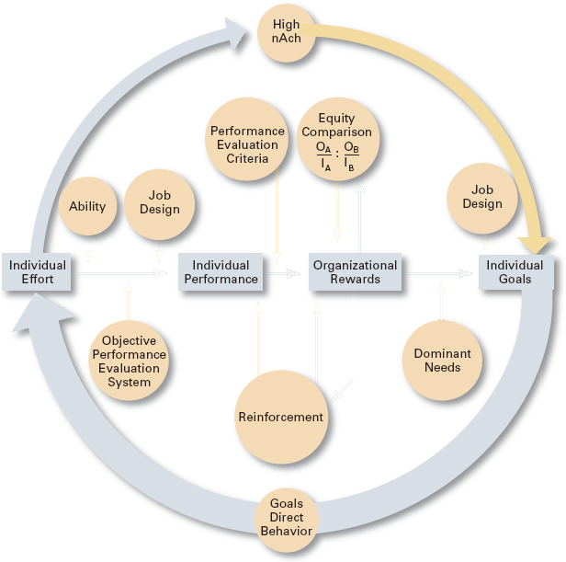
Exhibit 16–10 Integrating Contemporary Theories of Motivation

Slide 32
Current Issues in Motivation
Cross-Cultural Challenges
  Motivational programs are most applicable in cultures where individualism and quality of life are cultural characteristics
    Uncertainty avoidance of some cultures inverts Maslow’s needs hierarchy.
    The need for achievement (nAch) is lacking in other cultures.
    Collectivist cultures view rewards as “entitlements” to be distributed based on individual needs, not individual performance.
  Cross-Cultural Consistencies
    Interesting work is widely desired, as is growth, achievement, and responsibility.

Slide 33
Current Issues in Motivation (cont’d)
Motivating Unique Groups of Workers
  Motivating a diverse workforce through flexibility:
    Men desire more autonomy than do women.
    Women desire learning opportunities, flexible work schedules, and good interpersonal relations.

Slide 34
Current Issues in Motivation (cont’d)
Flexible Work/Job schedules
  Compressed work week
    Longer daily hours, but fewer days
  Flexible work hours (flextime)
    Specific weekly hours with varying arrival, departure, lunch and break times around certain core hours during which all employees must be present.
  Job Sharing
    Two or more people split a full-time job.
  Telecommuting
    Employees work from home using computer links.

Slide 35
Current Issues in Motivation (cont’d)
Motivating Professionals
  Characteristics of professionals
    Strong and long-term commitment to their field of expertise.
    Loyalty is to their profession, not to the employer.
    Have the need to regularly update their knowledge.
    Don’t define their workweek as 8:00 am to 5:00 pm.
  Motivators for professionals
    Job challenge
    Organizational support of their work

Slide 36
Current Issues in Motivation (cont’d)
Motivating Contingent Workers
  Opportunity to become a permanent employee
  Opportunity for training
  Equity in compensation and benefits
Motivating Low-Skilled, Minimum-Wage Employees
  Employee recognition programs
  Provision of sincere praise

Slide 37
Current Issues in Motivation (cont’d)
Designing Appropriate Rewards Programs
  Open-book management
    Involving employees in workplace decision by opening up the financial statements of the employer.
  Employee recognition programs
    Giving personal attention and expressing interest, approval, and appreciation for a job well done.
  Pay-for-performance
    Variable compensation plans that reward employees on the basis of their performance:
      Piece rates, wage incentives, profit-sharing, and lump-sum bonuses

Slide 38
Current Issues in Motivation (cont’d)
Designing Appropriate Rewards Programs (cont’d)
  Stock option programs
    Using financial instruments (in lieu of monetary compensation) that give employees the right to purchase shares of company stock at a set (option) price.
    Options have value if the stock price rises above the option price; they become worthless if the stock price falls below the option price.

Slide 39
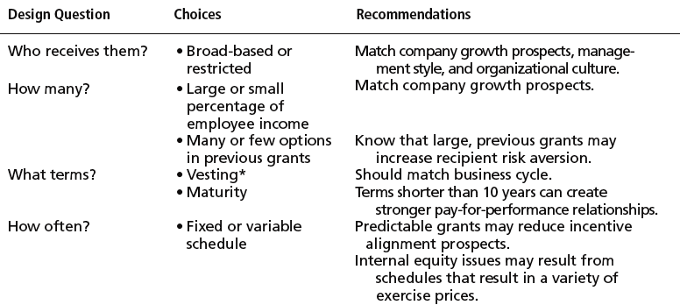
Exhibit 16–11 Recommendations for Designing Stock Options
* Vesting refers to the time that must pass before a person can exercise the option.
Source: P. Brandes, R. Dharwadkar, and G.V. Lemesis, “Effective Employee Stock Option Design: Reconciling Stakeholder, Strategic, and Motivational Factors,” Academy of Management Executive, February 2003, p. 84.

Slide 40
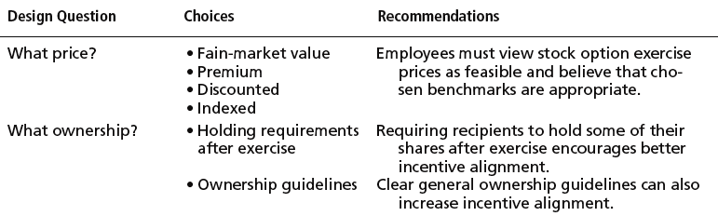
Exhibit 16–11 (cont’d) Recommendations for Designing Stock Options
Source: P. Brandes, R. Dharwadkar, and G.V. Lemesis, “Effective Employee Stock Option Design: Reconciling Stakeholder, Strategic, and Motivational Factors,” Academy of Management Executive, February 2003, p. 84.

Slide 41
From Theory to Practice:
Guidelines for Motivating Employees
Use goals
Ensure that goals are perceived as attainable
Individualize rewards
Link rewards to performance
Check the system for equity
Use recognition
Show care and concern for employees
Don’t ignore money

Slide 42
Terms to Know
motivation
hierarchy of needs theory
physiological needs
safety needs
social needs
esteem needs
self-actualization needs
Theory X
Theory Y
motivation-hygiene theory
hygiene factors
motivators
three-needs theory
need for achievement (nAch)
need for power (nPow)
need for affiliation (nAff)
goal-setting theory
self-efficacy
reinforcement theory
reinforcers
job design
job scope
job enlargement

Slide 43
Terms to Know (cont’d)
job enrichment
job depth
job characteristics model (JCM)
skill variety
task identity
task significance
autonomy
feedback
equity theory
referents
distributive justice
procedural justice
expectancy theory
compressed workweek
flexible work hours (flextime)
job sharing
telecommuting
open-book management
employee recognition programs
pay-for-performance programs
stock options

